Slide 1


進度報告
指導教授：國立中央大學 光電科學與工程學系 楊宗勳 教授
學生：國立中央大學 光電科學與工程學系碩士班
周慧岳

Slide 2
15K_Generations_固定LED半高寬Result

Slide 3
15K_Generations_固定LED半高寬Result

Slide 4
15K_Generations_固定LED半高寬Result

Slide 5
Comparison

Slide 6
Comparison

Slide 7
Comparison

Slide 8
4000K & 4500K 測試
130K代 11878.532s
4000-94.458
4500-94.1279
100K代 9449.998 s
4000-94.355431595681
4500-94.062300186215
200K代
4000-93.92
4500- 94.028
150K代
4000-94.08513
4500-94.1349514
300K代 23942.826s
4000-93.441220806345
4500-94.284045786122
400K代 32499.698s
4000-93.959568311845
4500-94.274598933364

Slide 9
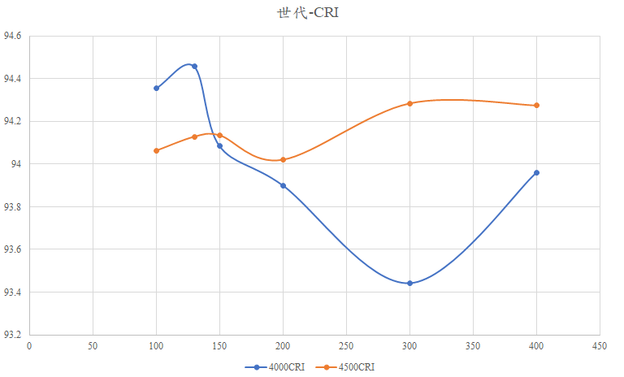

Slide 10
130K_Generations_Result

Slide 11
130K_Generations_Result

Slide 12
130K_Generations_Result

Slide 13
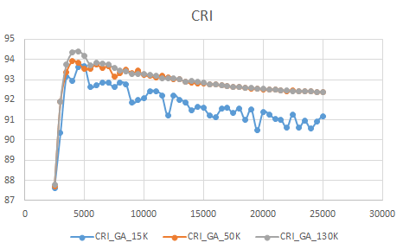
Comparison

Slide 14
Comparison

Slide 15
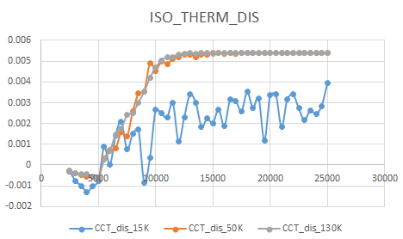

Slide 16
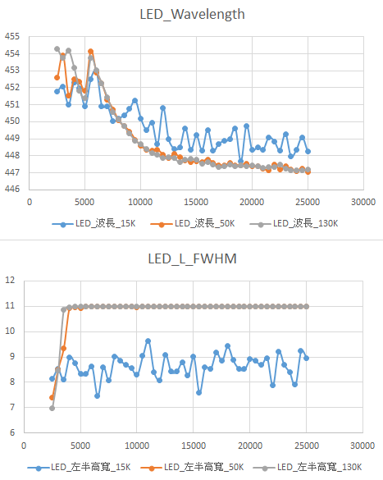
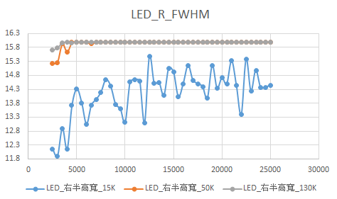
Comparison

Slide 17
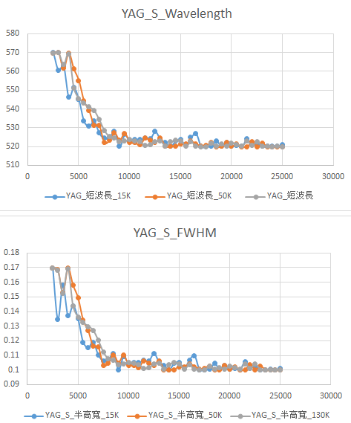
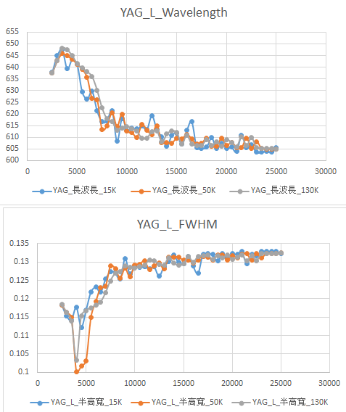
Comparison

Slide 18
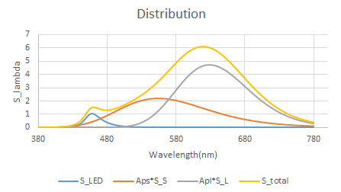
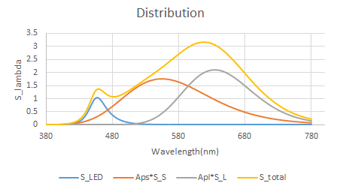
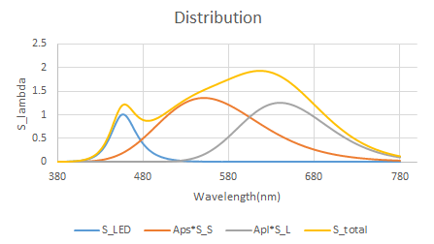
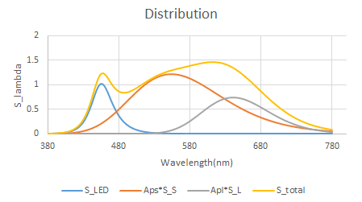
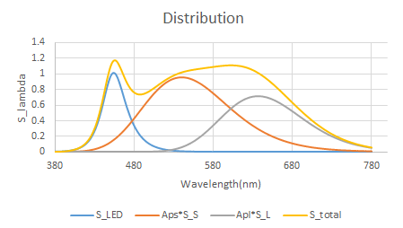
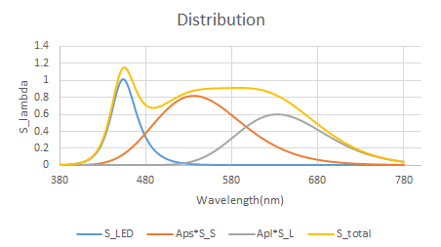
2500K
CRI=87.78008612
3000K
CRI=91.91242002
3500K
CRI= 93.74866951
4000K
CRI= 94.3454177
4500K
CRI= 94.41199399
5000K
CRI= 94.18041537

Slide 19
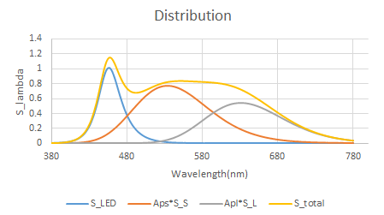
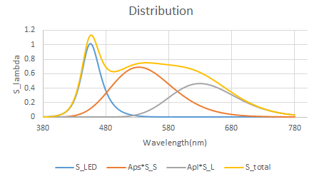
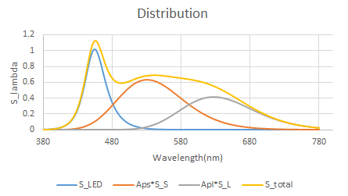
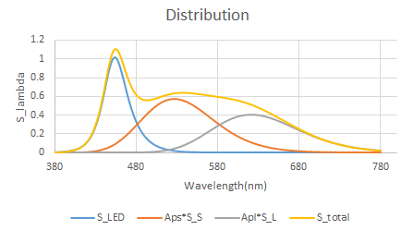
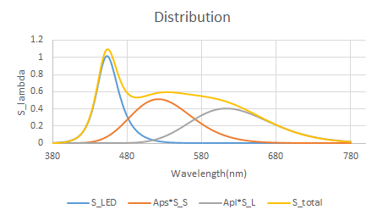
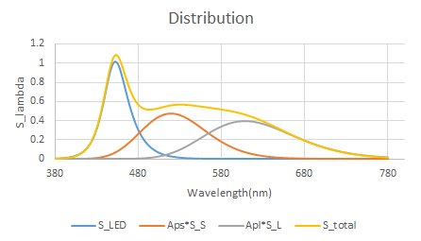
5500K
CRI= 93.7262001
6000K
CRI= 93.81940887
6500K
CRI= 93.81670848
7000K
CRI= 93.73976819
7500K
CRI= 93.58879513
8000K
CRI= 93.44347383

Slide 20
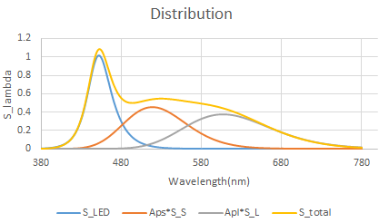
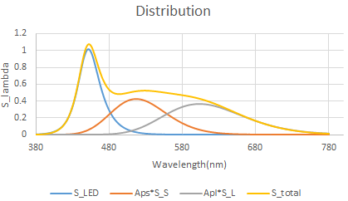
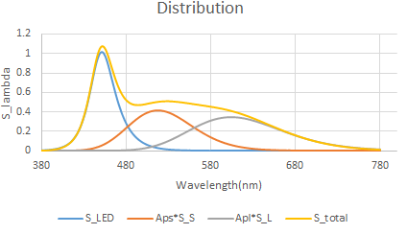
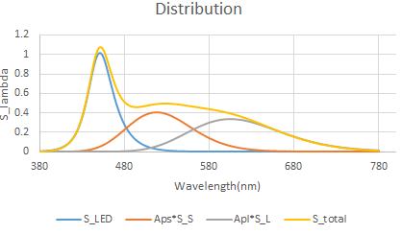
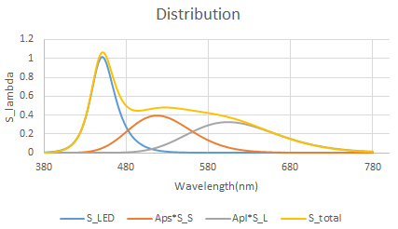
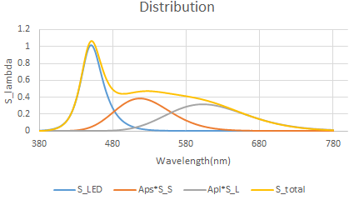
8500K
CRI= 93.40335754
9000K
CRI= 93.27002264
9500K
CRI= 93.29079814
10000K
CRI= 93.29222486
10500K
CRI= 93.24388334
11000K
CRI= 93.18503985

Slide 21
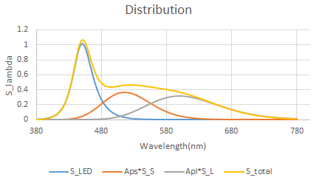
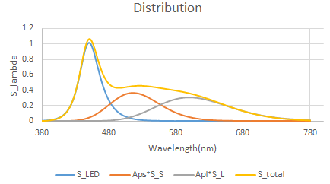
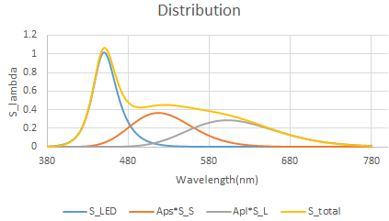
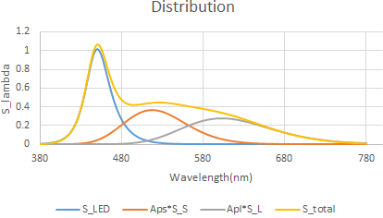
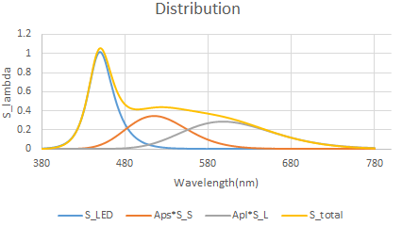

11500K
CRI= 93.06778942
12000K
CRI= 93.05031626
12500K
CRI= 93.0672193
13000K
CRI= 93.03089777
13500K
CRI= 92.90671915
14000K
CRI= 92.92692734

Slide 22
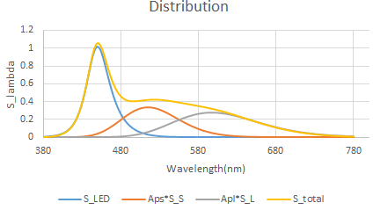
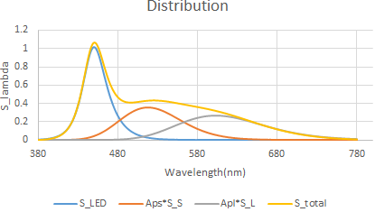
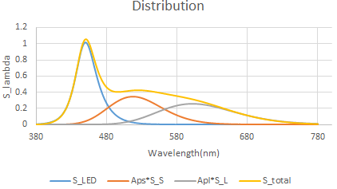
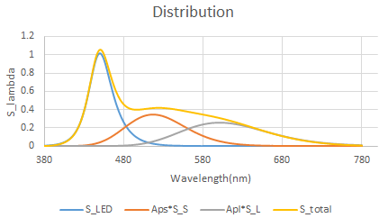
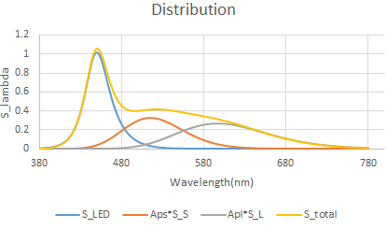
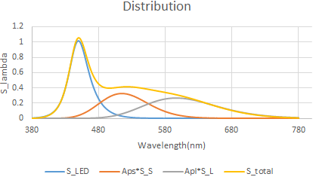
14500K
CRI= 92.89320639
15000K
CRI= 92.84377209
15500K
CRI= 92.76699122
16000K
CRI= 92.76689061
16500K
CRI= 92.70338194
17000K
CRI= 92.67224071

Slide 23
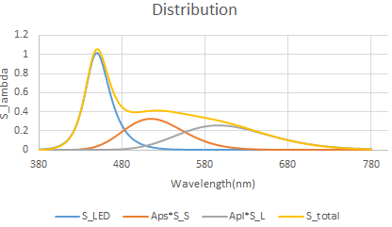
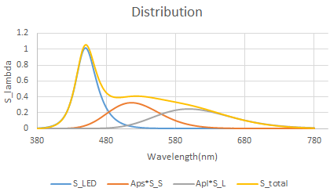

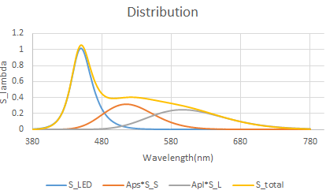
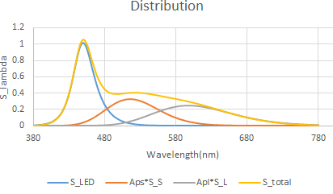
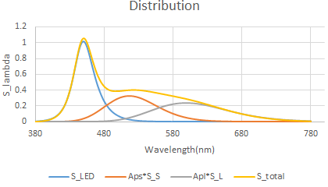
17500K
CRI= 92.6441969
18000K
CRI= 92.63409265
18500K
CRI= 92.59802621
19000K
CRI= 92.58038237
19500K
CRI= 92.54962208
20000K
CRI= 92.53324282

Slide 24
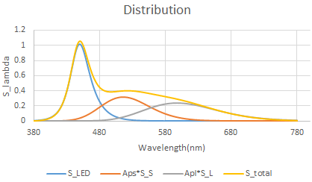


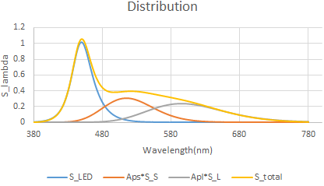
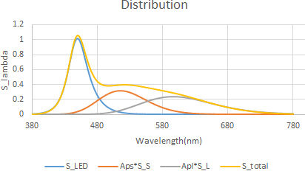
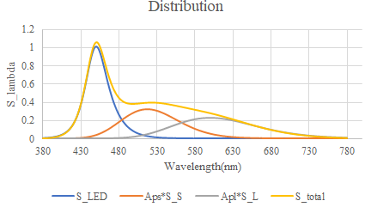
20500K
CRI= 92.51495351
21000K
CRI= 92.49466223
21500K
CRI= 92.46150135
22000K
CRI= 92.46206231
22500K
CRI= 92.42635803
23000K
CRI= 92.43386909

Slide 25

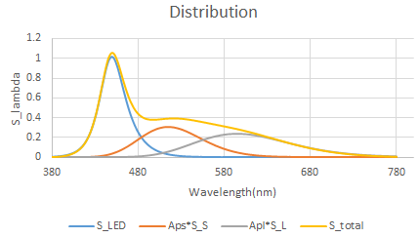
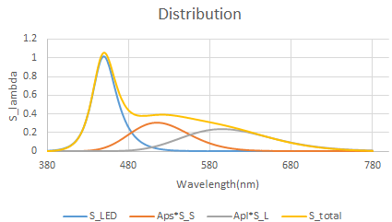
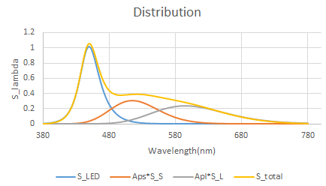
23500K
CRI=92.42259821
24000K
CRI= 92.4105032
24500K
CRI= 92.40006089
25000K
CRI=92.39002081

Slide 26
結論
世代會影響曲線的平整性
但仍然有微小跳動

Slide 27
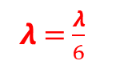
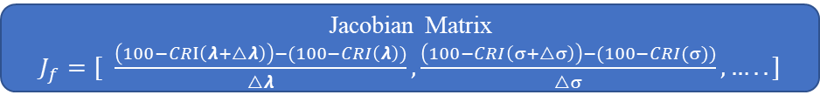









L-M
Genetic Algorithm
△$λ_{B}$ =8e-5 $λ_{B}$
△$σ_{BL}$=1e-3 $σ_{BL}$
△$σ_{BR}$=1e-4 $σ_{BR}$
△$λ_{S}$ =1e-4 $λ_{S}$
△$σ_{B}$ =5e-5 $σ_{B}$
△$λ_{L}$ =1e-6 $λ_{L}$
△$σ_{L}$ =1e-5 $σ_{L}$
△$D_{V}$ =1e-3 $D_{V}$
最佳結果
100-CRI ( $λ_{B1}$ ,$σ_{BL1},$ $σ_{BR1},λ_{S1},σ_{S1}$, $λ_{L1}$, $σ_{L1}$, $D_{v1}$)
$λ_{init}$= $0$.001
Jacobian Matrix
$J_{f}=[$ $\frac{\left(100−CRI\left(λ+△λ\right)\right)−(100−CRI\left(λ\right))}{△λ},\frac{\left(100−CRI\left(σ+△σ\right)\right)−(100−CRI(σ))}{△σ},…..]$
𝞴 = $\frac{λ}{6}$
Hessian Matrix$≈ {J_{f}}^{T}J_{f}^{}$
𝞴 = $1.2λ$
$P_{n+1}=P_{n}−{[{J_{f}}^{T}J_{f}^{}+λI]}^{−1}$ $J_{f}^{T}r$
(where r= Residual vector)
Residual Vector
$$\left(100−CRI\left(λ+△λ\right)\right)−\left(100−CRI\left(λ\right)\right)$$
$$\left(100−CRI\left(σ+△σ\right)\right)−(100−CRI\left(σ\right))$$
.
.
.
.
.
CRI (NEW)
CRI(NEW) > CRI
CRI(NEW) < CRI
100-CRI ($λ_{NEW}$ ,$σ_{NEW},$ $σ_{NEW}….,$)
100-CRI ($λ_{B1}$ ,$σ_{BL1},$ $σ_{BR1}….,$)

Slide 28

Tc 2500K LM 過程
初始數據
判斷是否符合物理條件
0:符合
1:不符合

Slide 29


Slide 30



Slide 31




Slide 32







2500K
CRI=87.71843144
3000K
CRI=91.89884499
3500K
CRI= 93.36088817
4000K
CRI= 93.92337823
4500K
CRI= 93.82650578
5000K
CRI= 93.53545224

Slide 33






5500K
CRI= 93.55699512
6000K
CRI= 93.76917779
6500K
CRI= 93.57095701
7000K
CRI= 93.65519097
7500K
CRI= 93.16686633
8000K
CRI= 93.32295991

Slide 34






8500K
CRI= 93.50756271
9000K
CRI= 93.31856183
9500K
CRI= 93.43914
10000K
CRI= 93.2241458
10500K
CRI= 93.1939638
11000K
CRI= 93.09518732

Slide 35






11500K
CRI= 93.18258988
12000K
CRI= 93.10893677
12500K
CRI= 93.04231145
13000K
CRI= 93.03494687
13500K
CRI= 92.87782366
14000K
CRI= 92.85603511

Slide 36






14500K
CRI= 92.82369738
15000K
CRI= 92.82508349
15500K
CRI= 92.78713639
16000K
CRI= 92.7564164
16500K
CRI= 92.71930498
17000K
CRI= 92.67107976

Slide 37






17500K
CRI= 92.64834037
18000K
CRI= 92.63038083
18500K
CRI= 92.58655961
19000K
CRI= 92.56379129
19500K
CRI= 92.55207527
20000K
CRI= 92.52754718

Slide 38






20500K
CRI= 92.51126303
21000K
CRI= 92.48896574
21500K
CRI= 92.47190198
22000K
CRI= 92.44470789
22500K
CRI= 92.4461074
23000K
CRI= 92.42049095

Slide 39




23500K
CRI= 92.41836272
24000K
CRI= 92.40641665
24500K
CRI= 92.39513501
25000K
CRI= 92.38777233

Slide 40








Levenberg Marquardt Optimization
Genetic Algorithm
[ɛ($P_{n+1}$)]
[ɛ($P_{n}$)]]
最佳結果
100-CRI ( $λ_{B1}$ ,$σ_{BL1},$ $σ_{BR1},λ_{S1},σ_{S1}$, $λ_{L1}$, $σ_{L1}$, $D_{v1}$)
False λ = 10λ
Calculate
[ɛ($P_{n+2}$)]<[ɛ($P_{n}$)]]?
Jacobian Matrix
$J_{f}=[$ $\frac{CRI(λ+△λ)−CRI\left(λ\right)}{△λ},\frac{CRI(σ+△σ)−CRI(σ)}{△σ},…..]$
True λ = $\frac{1}{10}$λ
[ɛ($P_{n+2}$)]
[ɛ($P_{n+1}$)]]
Hessian Matrix
$${J_{f}}^{T}J_{f}^{}$$
Calculate
$P_{n+1}=P_{n}−{[{J_{f}}^{T}J_{f}^{}+λI]}^{−1}$ $J_{f}^{T}ɛ$
(where ɛ= 100-CRI)
.
.
.

Slide 41


Slide 42


Slide 43


Slide 44





2500K
CRI= 87.63344
3000K
CRI= 90.36365
3500K
CRI= 93.14639
4000K
CRI= 92.93769
4500K
CRI= 93.63356
5000K
CRI= 93.68401

Slide 45






5500K
CRI= 92.64159
6000K
CRI= 92.7066
6500K
CRI= 92.85648
7000K
CRI= 92.83513
7500K
CRI= 92.63381
8000K
CRI= 92.86549

Slide 46






8500K
CRI= 92.76891
9000K
CRI= 91.85306
9500K
CRI= 91.97733
10000K
CRI= 92.05914
10500K
CRI= 92.43866
11000K
CRI= 92.41603

Slide 47






11500K
CRI= 92.22525
12000K
CRI= 91.21459
12500K
CRI= 92.19245
13000K
CRI= 92.00416
13500K
CRI= 91.87896
14000K
CRI= 91.4749

Slide 48






14500K
CRI= 91.66253
15000K
CRI= 91.59424
15500K
CRI= 91.22843
16000K
CRI= 91.15433
16500K
CRI= 91.54778
17000K
CRI= 91.6032

Slide 49






17500K
CRI= 91.34207
18000K
CRI= 91.57627
18500K
CRI= 91.0155
19000K
CRI= 91.51801
19500K
CRI= 90.50792
20000K
CRI= 91.3937

Slide 50






20500K
CRI= 91.28442
21000K
CRI= 91.03869
21500K
CRI= 91.01298
22000K
CRI= 90.62023
22500K
CRI= 91.28128
23000K
CRI= 90.63812

Slide 51




23500K
CRI= 90.96542
24000K
CRI= 90.56195
24500K
CRI= 90.91828
25000K
CRI= 91.19389

Slide 52


(nm)
(nm)
(nm)
Tc (K)
Tc (K)
Tc (K)
(nm)
(nm)
(nm)
Tc (K)
(nm)
Tc (K)
Tc (K)
Tc (K)

Slide 53


CRI
與學長結果比較
CRI
CRI
Tc (K)
CRI趨勢
Tc (K)

Slide 54








As & Al
$A_{S}$ =$\frac{γ\left(IT_{B}+J\right)−T_{L}(Iβ−αJ)}{γ(αT_{L}− γ−IT_{s})}$
$A_{L}$ =$\frac{−γ\left(αT_{B}+β\right)−T_{S}(Iβ−αI)}{γ(αT_{L}− γ−IT_{s})}$
I =$Y_{L}x_{c} −X_{L}y_{c}$
$T_{B}$ =$X_{B}{+Y}_{B}+Z_{B}$
J =$X_{L}Y_{B}−Y_{L}X_{B}$
$T_{S}$ =$X_{S}{ +Y}_{S} +Z_{S}$
γ =$Y_{S}X_{L}−Y_{L}X_{S}$
$T_{L}$ =$X_{L}{ +Y}_{L} +Z_{L}$
α =$Y_{S}x_{c}−y_{c}X_{S}$
β =$X_{S}Y_{B}−Y_{S}X_{B}$

Slide 55

m= -0.00040385
FWHM= -0.00042857*𝞴+0.37657055
const= 0.3463523
0.01515
0.01515

Slide 56

m=0.0014
const=-0.666
FWHM= 0.0014*𝞴-0.666
0.03814
0.03814

Slide 57


Slide 58


Result

Slide 59

CRI & Dv

Slide 60






2500K
CRI= 89.30026
3000K
CRI= 82.4411
3500K
CRI= 81.44312
4000K
CRI= 88.03679
4500K
CRI= 89.73599
5000K
CRI= 91.71916

Slide 61






5500K
CRI= 90.00838
6000K
CRI= 91.08308
6500K
CRI= 90.58444
7000K
CRI= 91.6629
7500K
CRI= 92.33326
8000K
CRI= 92.5618

Slide 62






8500K
CRI= 92.86123
9000K
CRI= 93.22622
9500K
CRI= 93.35116
10000K
CRI= 93.59992
10500K
CRI= 93.69527
11000K
CRI= 93.75413

Slide 63






11500K
CRI= 93.77335
12000K
CRI= 93.8604
12500K
CRI= 93.92866
13000K
CRI= 93.93584
13500K
CRI= 93.97275
14000K
CRI= 93.98423

Slide 64






14500K
CRI= 94.04995
15000K
CRI= 94.08157
15500K
CRI= 94.04325
16000K
CRI= 94.07525
16500K
CRI= 94.11823
17000K
CRI= 94.14825

Slide 65






17500K
CRI= 94.09928
18000K
CRI= 94.1268
18500K
CRI= 94.19179
19000K
CRI= 94.24988
19500K
CRI= 93.98662
20000K
CRI= 94.16726

Slide 66






20500K
CRI= 94.23305
21000K
CRI= 94.2681
21500K
CRI= 94.17411
22000K
CRI= 94.07556
22500K
CRI= 94.22297
23000K
CRI= 94.13955

Slide 67




23500K
CRI= 94.22042
24000K
CRI= 94.26587
24500K
CRI= 94.09434
25000K
CRI= 94.19717

Slide 68



驗證程式對錯

Slide 69








main
Gene Algorithm
量測波長上限
Chromosome
CRI
S_LED(𝞴)
S_SHORT(𝞴)
S_LONG(𝞴)
量測波長下限
LED_𝞴
xc yc
量測間格
LED_𝞂-l
Aps Apl
TCS數量(1-14)
LED_𝞂-r
S_Total(𝞴)
S_Illuminant(𝞴)
Short_𝞴
TCS1-8(𝞴)
Tc
Excel_Open
Short_𝞂
Long_𝞴
Long_𝞂
$${(c}_{k} ,d_{k})$$
${(c}_{ki} ,d_{ki})$
$${(c}_{ri} ,d_{ri})$$
$${(c}_{r} ,d_{r})$$
Isotherm_d
等色溫線 u v
${(u′}_{ki} ,{v′}_{ki})$
$${ (u′}_{ri} ,{v′}_{ri})$$
Bubble Sort
Survivors Crossover
Mutate
等色溫線 xy
回去重新求
Aps Apl
$$\text{W}\text{∗}\text{U}\text{∗}\text{V}\text{∗}$$
$$CRI$$
Best Result

Slide 70


Result

Slide 71

波長比例關係

Slide 72

























決定色溫 $T_{cp}$
Plank radiator
$M_{e}\left(λ\right)=\frac{c_{1}}{λ^{5}}( \frac{1}{e^{{c_{2}}/{λT}}−1}$ )
Illuminant
TCS1 (𝞴) ~TCS8 (𝞴)
Test
S_total(𝞴)
Eq 1.
x$=k\int_{vis}{TCSi\left(\text{λ}\right)P_{r ,or k}(\text{λ})}\overline{x }ⅆ\text{λ}$
Eq 1.
Eq 1.
y$=k\int_{vis}{TCSi\left(\text{λ}\right)P_{r ,or k}(\text{λ})}\overline{y }ⅆ\text{λ}$
${(x}_{r} ,y_{r})$
${(u}_{r} ,v_{r})$
Eq 2.
${(x}_{ki} ,y_{ki})$
${(u}_{ki} ,v_{ki})$
${(x}_{k} ,y_{k})$
$${(u}_{k} ,v_{k})$$
${(x}_{ri} ,y_{ri})$
${(u}_{ri} ,v_{ri})$
Eq 2.
z$=k\int_{vis}{TCSi\left(\text{λ}\right)P_{r ,or k}(\text{λ})}\overline{z }ⅆ\text{λ}$
Eq 2.
Eq 3.
Eq 3.
Eq 3.
Eq 2.
${(c}_{ki} ,d_{ki})$
$${(c}_{ri} ,d_{ri})$$
u= $\frac{4X}{X+15Y+3Z }$ = $\frac{4x}{−2x+12y+3}$
${(c}_{r} ,d_{r})$
${(c}_{k} ,d_{k})$
v= $\frac{6Y}{X+15Y+3Z }$ = $\frac{6y}{−2x+12y+3}$
Eq 4.
Eq 3.
${(u′}_{ki} ,{v′}_{ki})$
${(u′}_{ri} ,{v′}_{ri})$
c = $\frac{4−u−10v}{v}$
d = $\frac{1.708v+0.404−1.481u}{v}$
Eq 5.
Eq 5.
CIE1964 W*U*V*
W* = 25$Y^{\frac{1}{3}}$ - 17
等色溫線
xc & yc shift 改變Aps Apl
找最小CRI
U* = 13W*($u$-${ u}_{n}$)
Eq 4.
V* = 13W*($v$-${ v}_{n}$)
${u′}_{k,i}=\frac{10.872+0.404c_{r}\frac{c_{k,i}}{c_{k}}−4d_{r}\frac{d_{k,i}}{d_{k}}}{16.518+1.481c_{r}\frac{c_{k,i}}{c_{k}}−d_{r}\frac{d_{k,i}}{d_{k}}}$
Eq 6.
△$E_{i}$
${v′}_{k,i}=\frac{5.52}{16.518+1.481c_{r}\frac{c_{k,i}}{c_{k}}−d_{r}\frac{d_{k,i}}{d_{k}}}$
Eq 6.
$$R_{a}=\frac{\sum_{i=1}^{8}{(100−4.6\text{△}E_{i}})}{8}$$
$\text{△}E_{i}$ = $\left\{{(U}_{r,i}^{∗}\right.−U_{k,i}^{∗})^{2}+(V_{r,i}^{∗}−V_{k,i}^{∗})^{2}$+${(W}_{r,i}^{∗}−W_{k,i}^{∗})^{2}\}^{\frac{1}{2}}$

Slide 73






等色溫線斜率
l=$\frac{dv}{du}=\frac{dv/dT}{du/dT}=\frac{(XY′−X′Y)+3(Y′Z−YZ′)}{2(X′Z−Z′X)+10(X′Y−XY′)}$
m = -1/l
$$X^{′}=\frac{dX}{dT}=\int_{vis}{P′(λ,T})\overline{x}(λ)dλ$$
$$Y^{′}=\frac{dY}{dT}=\int_{vis}{P′(λ,T})\overline{y}(λ)dλ$$
$$Z^{′}=\frac{dZ}{dT}=\int_{vis}{P′(λ,T})\overline{z}(λ)dλ$$
$P^{′}($𝞴,T)=dP(𝞴,T)/dT=$\frac{c1c2}{λ^{6}T^{2}}e^{\frac{c2}{λT}}{[e^{\frac{c2}{λT}}−1]}^{−2}$

Slide 74








Block Diagram
$$S_Led(λ)=\frac{2Ab}{e^{\frac{λb−λ}{σ_bL}}+e^{\frac{λ−λb}{σ_bR}}}$$
$$,S_s(λ)=As({\frac{λs}{λ})}^{2}e^{−{(\frac{λ−λs}{λσs})}^{2} }$$
$$,S_L(λ)=AL({\frac{λL}{λ})}^{2}e^{−{(\frac{λ−λL}{λσL})}^{2} }$$
1. Spectrum to XYZ
X$=683\int_{380}^{780}{S\left(λ\right)CIE_x\left(λ\right)dλ}$
Y$=683\int_{380}^{780}{S\left(λ\right)CIE_y\left(λ\right)dλ}$
Z$=683\int_{380}^{780}{S\left(λ\right)CIE_z\left(λ\right)dλ}$
2. XYZ to xy
3. Calculate the ratio
x = $\frac{X}{X+Y+Z}$
y = $\frac{Y}{X+Y+Z}$
1 : Aps : Apl
4. Calculate S_total
S_total($λ$)= $S_Led(λ)$+Aps *$S_s(λ)$+ Apl* $S_L(λ)$
5. Calculate CRI
CRI

Slide 75
Process
Amplutude_Equation.c
Compile
Amplutude_Equation.o
Bluerate.c
Compile
Bluerate.o
Excel_fileopen.c
Compile
Excel_fileopen.o
Gene_algo_main.c
Compile
Gene_algo_main.o
Link
.exe
CRI.c
Compile
CRI.o
Matrix_random.c
Compile
Matrix_random.o
Tristimulus_values.c
Compile
Tristimulus_values.o
XYZ2xy.c
Compile
XYZ2xy.o

Slide 76
Summary
程式架構修改
S_phosphors 的公式計算下，波長與半高寬變動與xy座標變化關係極小

Slide 77



Block Diagram CRI
4000K<Tcp<7000K
$x_{D}=\frac{−4.0507∗{10}^{9}}{{Tcp}^{3}}+\frac{2.9678∗{10}^{6}}{{Tcp}^{2}}$+$\frac{0.09911∗{10}^{3}}{Tcp}+0.244063$
7000K<Tcp<25000K
$x_{D}=\frac{−2.0064∗{10}^{9}}{{Tcp}^{3}}+\frac{1.9081∗{10}^{6}}{{Tcp}^{2}}$+$\frac{0.24748∗{10}^{3}}{Tcp}+0.23704$
$y_{D}=−3{x_{D}}^{2}$+2.873$x_{D}$-0.275
CCT$=437n^{3}$+3$601n^{2}+6861n+5517$
n = $\frac{x−0.332}{0.1858−y}$

Slide 78




Result
$$S_Led(λ)=\frac{2Ab}{e^{\frac{λb−λ}{σ_bL}}+e^{\frac{λb−λ}{σ_bR}}}$$
$$,S_s(λ)=As({\frac{λs}{λ})}^{2}e^{−{(\frac{λ−λs}{λσs})}^{2} }$$
$$,S_L(λ)=AL({\frac{λL}{λ})}^{2}e^{−{(\frac{λ−λL}{λσL})}^{2} }$$

Slide 79
目錄
XYZ to uv
Blue rate
S(lambda)
CRI(S(illuminant),TCS(1-8),Stotal)
S to XY ,XY to ur
Ur to cd
cd to uki uri vki vri to U*W*V*

Slide 80









Block Diagram
$$S_Led(λ)=\frac{2Ab}{e^{\frac{λb−λ}{σ_bL}}+e^{\frac{λb−λ}{σ_bR}}}$$
CIE_1931
EXCEL資料導入
$$S_s(λ)=As({\frac{λs}{λ})}^{2}e^{−{(\frac{λ−λs}{λσs})}^{2} }$$
Main
CIE D65
$$S_L(λ)=AL({\frac{λL}{λ})}^{2}e^{−{(\frac{λ−λL}{λσL})}^{2} }$$
定義基因數值範圍
產生基因庫
計算SLED($λ$),Ss($λ$),SL($λ$)
計算刺激值XYZ
x$=\frac{X}{X+Y+Z}$
X$=683\int_{380}^{780}{S\left(λ\right)CIE_x\left(λ\right)CIED65\left(λ\right)dλ}$
Y$=683\int_{380}^{780}{S\left(λ\right)CIE_y\left(λ\right)CIED65\left(λ\right)dλ}$
y$=\frac{Y}{X+Y+Z}$
Z$=683\int_{380}^{780}{S\left(λ\right)CIE_z\left(λ\right)CIED65\left(λ\right)dλ}$

Slide 81


結果

Slide 82

Conclusions & Future work
目前的結果Ss($λ$), Sl($λ$) xy座標 結果似乎有異常

Slide 83
目錄
Block Diagram
程式結果
Conclusions & Future Work
Reference

Slide 84

Block Diagram
不同x代入同組染色體 的值
基因
…
x20
Loss
4
亂數產生 gene=[-1,1]
x1
亂數產生 x=[-1,1]
染色體1
Σ
…
染色體2
Σ
染色體數目
…
a0
a1
a2
a3
Model=a0+a1*x+a2*x^2+a3*x^3
…
…
…
100
…
…
染色體100
Σ
逐一取出
進行RMSE計算
樣本數為20
Ground truth={a0,a1,a2,a3}={-0.1,0.3,-0.7,0.1}
Population
Sample=20
(每一組x算代入100個染色體,總共做20組x)
20
Population(survive)
Population
Loss
沒有存活下來的不同染色體且相同基因隨機進行crossover，且各個基因進行突變，突變率隨世代增加而遞減
染色體1
染色體2
Crossover
…
染色體100
將較好的結果與其染色體排列於前面存活下來

Slide 85

結果

Slide 86
Conclusions & Future work
目前要執行到15000個世代左右才可以達到穩定值，猜測此參考的演算法比較像突變演算法，演算法過程選擇母代擇優進行Crossover以及突變
計畫在程式改良，並且熟讀色彩學老師您指定章節後將之導入進行模擬

Slide 87
Reference
https://www.youtube.com/watch?v=7rHWyyD5Zaw
https://github.com/Jwalin1/C-programs/tree/master/Genetic%20Algorithm

